Slide 1
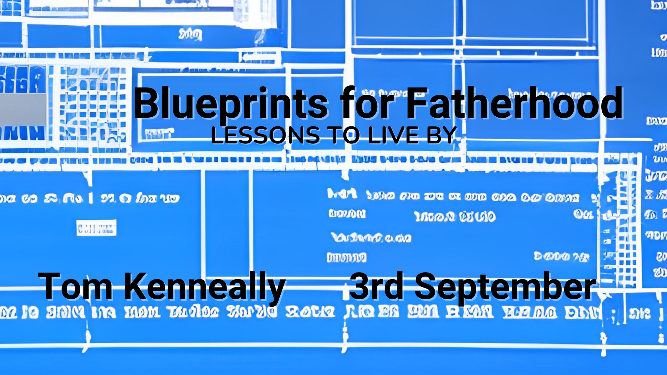

Slide 2
Father’s Day Fun Facts
The first Father’s day was celebrated in 1910
It was created in America
It was invited by a woman who had tragically lost her mum
The official flower of Father’s day is the rose
The date on which we celebrate Father’s day in Australia was decided in 1964.

Slide 3
Father’s Day is different for everyone
Father’s Day can be full of pain
Father’s Day can be full of celebration
Father’s Day can remind us of painful loss
Father’s Day can celebrate those who aren’t our actual fathers.

Slide 4
Fathers and father figures, you have a profound impact on your children, not only in their upbringing but also in their spiritual journey.

Slide 5
Provider
God is the ultimate provider!
Matt 6:31-33 - "So do not worry, saying, 'What shall we eat?' or 'What shall we drink?' or 'What shall we wear?' For the pagans run after all these things, and your heavenly Father knows that you need them. But seek first his kingdom and his righteousness, and all these things will be given to you as well."

Slide 6
Protector
God shield us from harm
Psalm 91:4 - "He will cover you with his feathers, and under his wings, you will find refuge; his faithfulness will be your shield and rampart."
Fathers should be a safe haven where guidance is provided

Slide 7
Disciplinarian
God’s disciple is an express of his love and concern.
Hebrews 12:6 - "For the Lord disciplines the one he loves, and chastises every son whom he receives."
Proverbs 3:11-12 - "My son, do not despise the Lord’s discipline or be weary of his reproof, for the Lord reproves him whom he loves, as a father the son in whom he delights."

Slide 8
Guide
God is frequently portrayed as Our shepherd, our guide.
Psalm 23 says - "The Lord is my shepherd; I shall not want. He makes me lie down in green pastures. He leads me beside still waters. He restores my soul. He leads me in paths of righteousness for his name's sake.“
Ephesians 6:4 - "Fathers, do not provoke your children to anger, but bring them up in the discipline and instruction of the Lord."

Slide 9
Unconditional Love – A Father’s Gift.
God’s love is unwavering, unconditional and boundless.
Romans 8:38-39 - , "For I am convinced that neither death nor life, neither angels nor demons, neither the present nor the future, nor any powers, neither height nor depth, nor anything else in all creation, will be able to separate us from the love of God that is in Christ Jesus our Lord."

Slide 10
Reflecting God’s Love
1 Corinthians 13:4-7
"Love is patient, love is kind. It does not envy, it does not boast, it is not proud. It does not dishonor others, it is not self-seeking, it is not easily angered, it keeps no record of wrongs. Love does not delight in evil but rejoices with the truth. It always protects, always trusts, always hopes, always perseveres."

Slide 11
Power of Acceptance
Just as God accepts us we should accept our children, flaws and all.
Acceptance doesn’t mean condoning behaviour or choice, it means embracing your children even when they have made mistakes.

Slide 12
Presence and Engagement
God’s ever presence is a comforting truth
Psalm 139:7-10 - "Where can I go from your Spirit? Where can I flee from your presence? If I go up to the heavens, you are there; if I make my bed in the depths, you are there. If I rise on the wings of the dawn, if I settle on the far side of the sea, even there your hand will guide me, your right hand will hold me fast."

Slide 13
Presence and Engagement
Kids are concrete thinkers, being physically present matters to them
Matt 28: 20 - "And surely I am with you always, to the very end of the age."
Your presence teaches kids things, like how reliable should you be in a relationship.

Slide 14
Emotional Presence
Presence does go beyond close proximity.
It is about creating an atmosphere of openness and availability
Does the way you parent assist or hinder the way you want your relationships to be.

Slide 15
Empowerment and Encouragement
God is the ultimate empowerer
2 Tim 1:7 - "For the Spirit God gave us does not make us timid, but gives us power, love, and self-discipline."
Affirmation through Words, Fostering Resilience, Supporting Their Passions, Teaching independence, are ways to Empower and Encourage.

Slide 16
God’s Ultimate plan
"But God demonstrates his own love for us in this: While we were still sinners, Christ died for us."

Slide 17
The Challenge
Demonstrate practical love towards someone special today!
Dad’s to their kids, husbands to wives, kids to parents etc.

